Slide 1
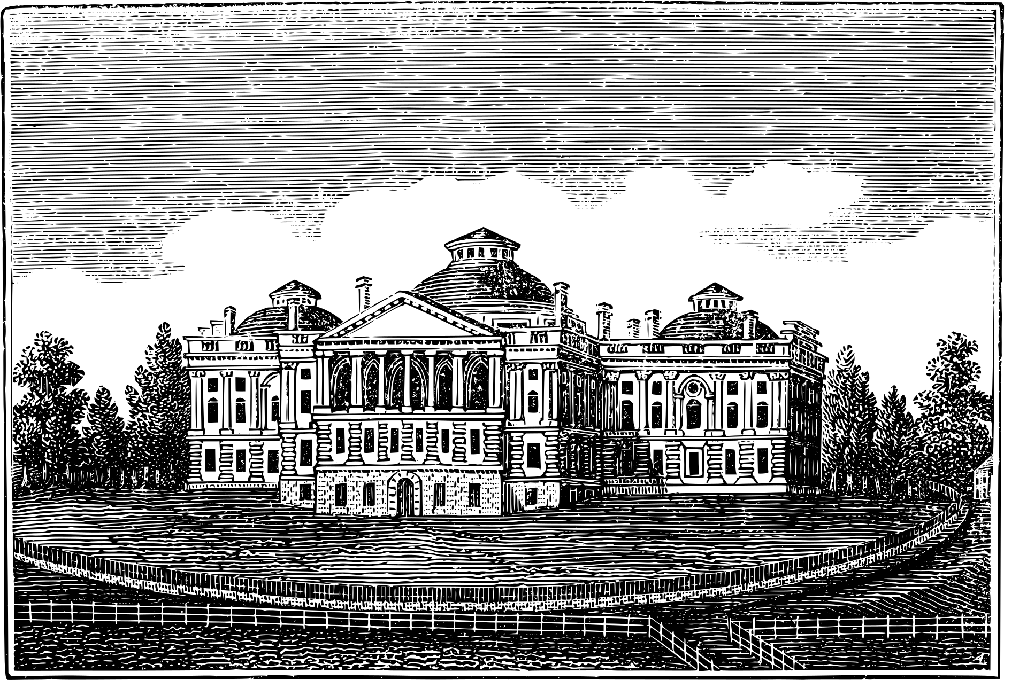
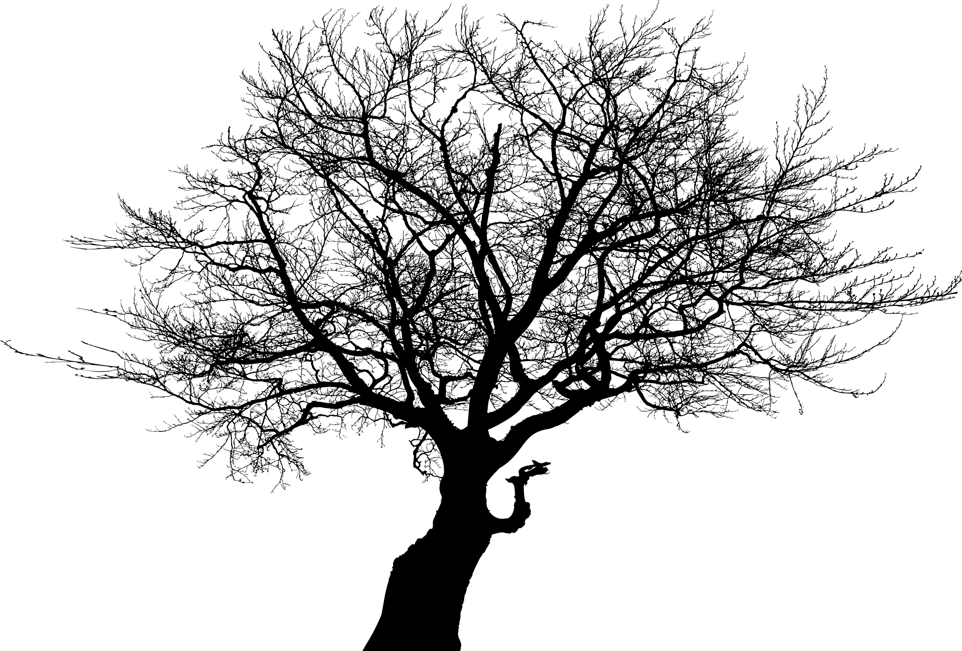


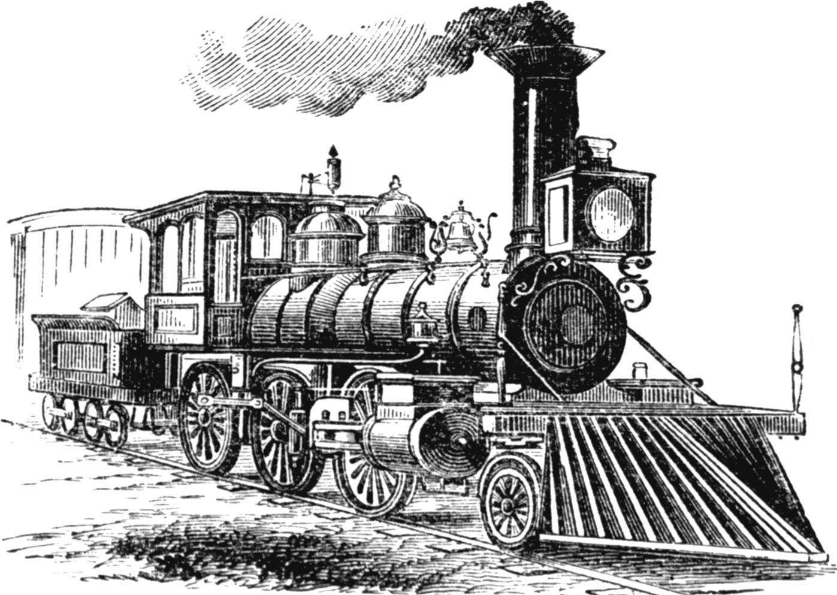
DIGITAL PORTFOLIO
NAME: Vimalan.K
NMID: 21736688F765CDEBC8B422168107763A
DEPARTMENT: B.Sc Information Technology
COLLEGE: Kaamadhenu Arts And Science College / Bharathiar University

Slide 2
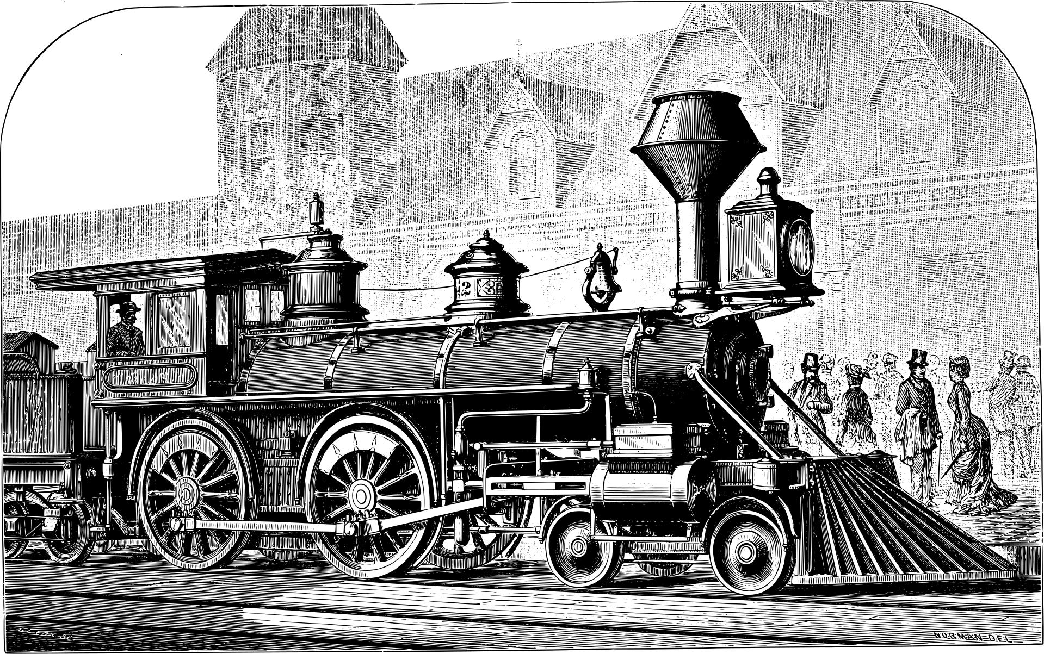

PROJECT TITLE
INDIAN RAILWAYS PORTFOLIO USING
HTML, CSS & JAVASCRIPT

Slide 3
AGENDA
1.Problem Statement
2.End Users
3.Tools and Technologies
4.Portfolio design and Layout
5.Features and Functionality
6.Results and Screenshots
7.Conclusion
8.Github Link

Slide 4
PROBLEM STATEMENT
• Indian Railways is one of the largest railway networks in the world, with a rich history of more than 170 years.
• However, most available information is either scattered across multiple platforms or presented in static, text-heavy formats.
• There is a lack of a modern, interactive portfolio that showcases:
• The legacy and milestones of Indian Railways.
• The scale of operations and services offered.
• Infrastructure projects shaping the future.
• Vision 2030 goals (high-speed rail, AI integration, carbon neutrality).
• Need for a centralized, visually appealing, and responsive platform that makes it easy for users to engage, explore, and learn.

Slide 5
PROJECT OVERVIEW
• Developed a portfolio-style website dedicated to Indian Railways.
• Purpose: To create an informative yet visually engaging platform that reflects the importance of Indian Railways.
• Key Focus Areas:
• Legacy of Indian Railways since 1853.
• Day-to-day operations and services (Express, Freight, Electrification).
• Infrastructure projects such as Vande Bharat, Dedicated Freight Corridor, Station Modernization.
• Milestones (historic timeline).
• Future vision (high-speed rail, AI integration, sustainability).
• Built with modern web technologies ensuring responsiveness, animations, and ease of navigation.

Slide 6
END USERS
• General Public / Citizens → Gain insights into the vastness and modernization of Indian Railways.
• Students & Researchers → Use as a knowledge resource for projects, presentations, and studies.
• Tourists & Travelers → Explore services, station details, and facilities before travel.
• Government Officials / Policy Makers → Demonstrate modernization projects and upcoming plans.
• Railway Employees / Stakeholders → Showcase Indian Railways’ achievements and transformation journey.

Slide 7
TOOLS AND TECHNOLOGIES
• Frontend Technologies:
• HTML5 & CSS3 → Structure and styling of web pages.
• Bootstrap 5 → Responsive grid system and UI components.
• Styling & Fonts:
• Google Fonts (Poppins) → Clean typography.
• Font Awesome → Scalable icons for trains, safety, energy, etc.
• Interactivity & Animations:
• JavaScript → Smooth scrolling and counter animations.
• CSS Animations → Fade-in, slide-in, hover effects.
• Design Aesthetics:
• Custom gradients (green, orange, gold, blue – inspired by Indian Railways).
• Rounded cards and shadow effects for modern UI.

Slide 8
PORTFOLIO DESIGN AND LAYOUT
• Navigation Bar (Fixed): Easy navigation across sections.
• Hero Section:
• Title with tagline “Connecting India’s Heart Since 1853”.
• Railway statistics (trains, passengers, stations, route kilometers).
• Legacy Section:
• Story of 170+ years.
• Key facts: first passenger train (1853), largest employer, 72% electrification.

Slide 9
• Operations Section:
• Service cards for Express, Freight, Safety, and Electrification.
• Infrastructure Projects:
• Highlight of flagship projects (Vande Bharat, DFC, Station Modernization).
• Timeline:
• Visual journey from 1853 to 2025.
• Future Vision 2030:
• Bullet trains, AI, carbon neutrality, global partnerships.
• Footer:
• Contact details, quick links, and social media icons.

Slide 10
FEATURES AND FUNCTIONALITY
• Interactive Navigation → Smooth scrolling between sections.
• Animated Counters → Real-time stats like passengers, trains, kilometers.
• Responsive Design → Works seamlessly on desktop, tablet, and mobile.
• Timeline Display → Chronological highlights of Indian Railways.
• Service & Project Cards → Attractive cards with hover animations.
• Modern Design → Gradient backgrounds, typography, and icons.
• Social Media Integration → Links to platforms like Facebook, Twitter, LinkedIn.

Slide 11
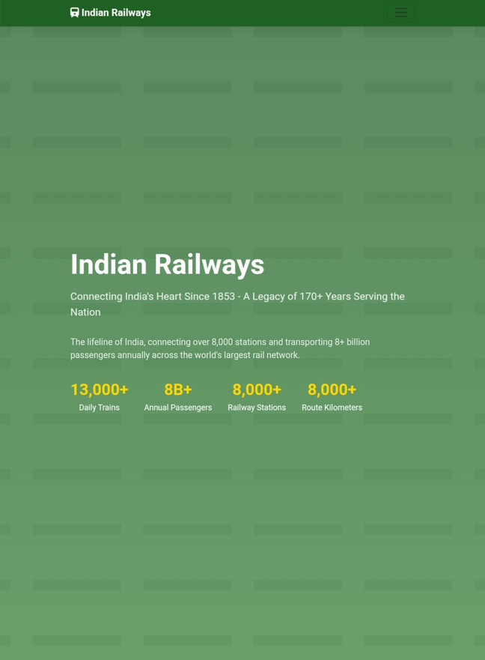
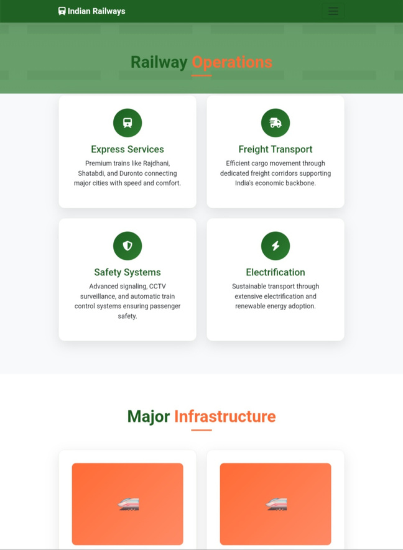
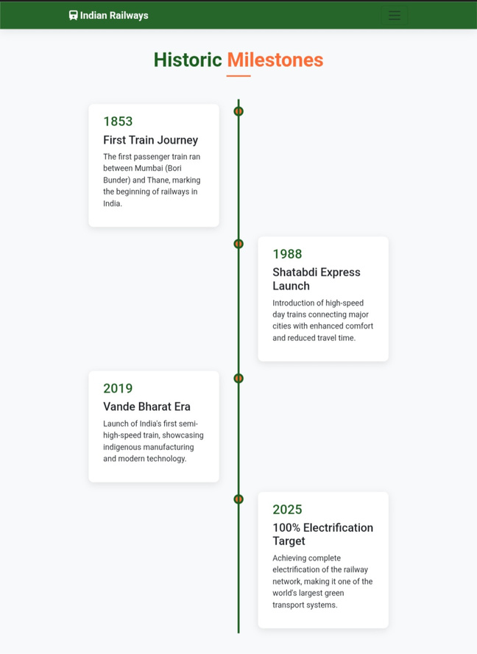
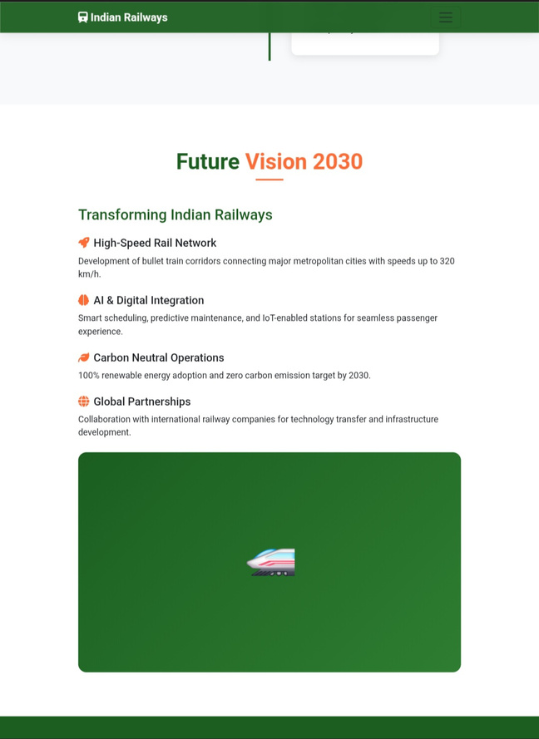
RESULTS AND SCREENSHOTS

Slide 12
Conclusion
• Developed a modern portfolio website showcasing Indian Railways’ journey, operations, and vision.
• Successfully combined history + present + future into a single interactive platform.
• Advantages:
• Enhances visibility and engagement.
• Serves as a learning and information hub.
• Provides a scalable base for future additions (real-time train tracking, booking integration).
• Future Enhancements:
• Integration with Indian Railways API for live train data.
• Multi-language support for wider accessibility.
• Expand to include virtual tours of modernized stations.

Slide 13
Thank You

